Slide 1

IRIS TUMOR DETECTION USING CNN
TEAM MEMBERS:
Preethi
Sowndarya Nandhagopal DATE:10.12.2024

Slide 2
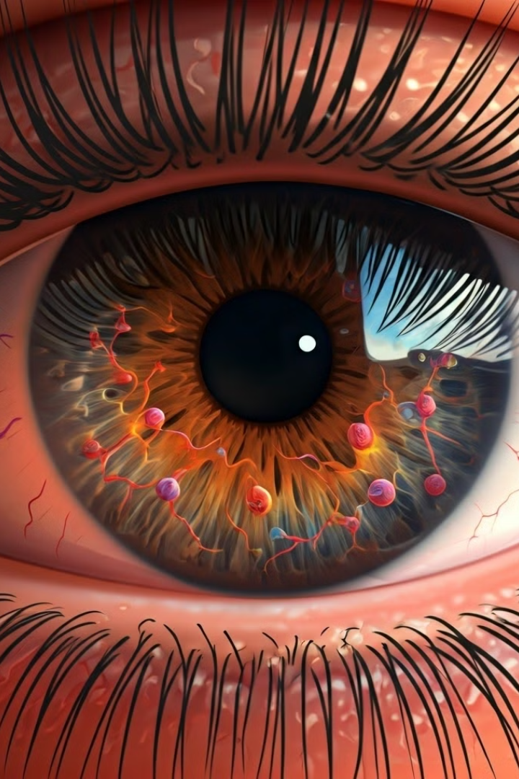
Iris Tumor Detection Using Convolutional Neural Networks
Introduction :
This project focuses on developing a deep learning model to detect tumors in iris images using Convolutional Neural Networks (CNN).
Traditional methods of detecting iris tumors can be time-consuming and dependent on specialist analysis. This project aims to automate detection using Convolutional Neural Networks (CNNs) to make the process faster, more consistent, and more accessible.
In this project, a CNN model is trained to identify and classify iris tumors from medical images, improving detection accuracy and aiding in early diagnosis.

Slide 3
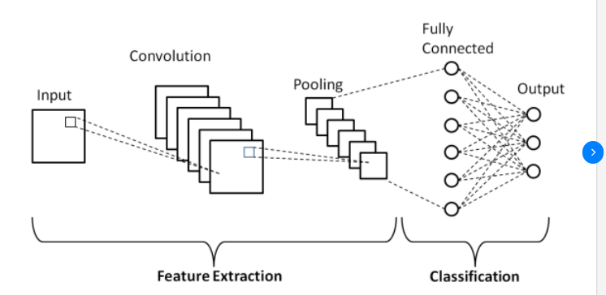
Problem Statement :
The Problem: Detecting iris tumors early is crucial
for better treatment outcomes.
Current Issues: Traditional methods are
time-consuming and often require specialist expertise.
Objective: To provide an automated, fast, and
accurate solution for detecting iris tumors from images using AI.
Proposed Solution :
Solution: A web-based application that allows users to upload iris images, which are processed by a trained CNN model to detect tumors.
Features:
User-friendly interface for image upload.
Real-time analysis and tumor detection.

Slide 4


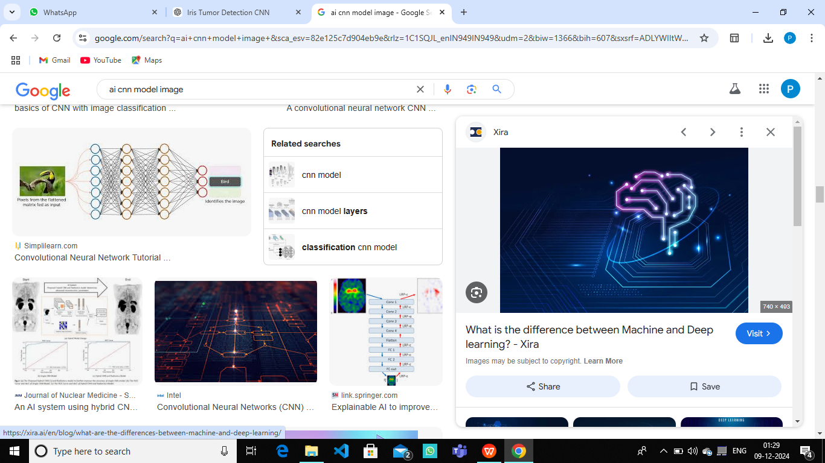
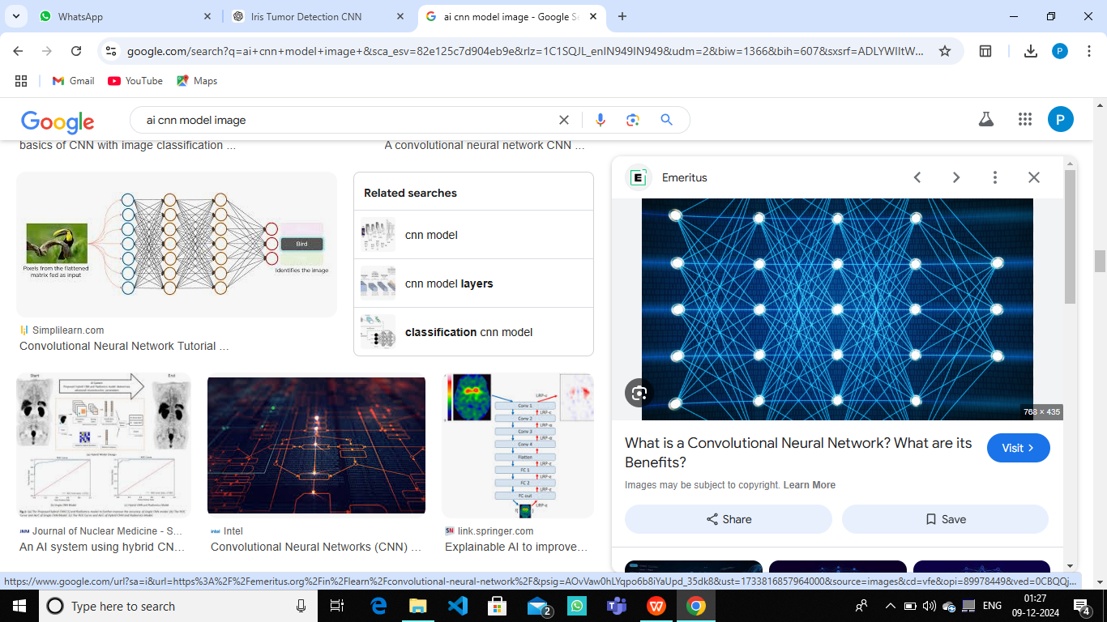
Project Overview
Customer features :
Register page :New username and password for successful registeration
Login page : login with username and password
About page : Giving the mission and vision about the project
Uploading file: uploading the file to detect the tumor
Detecting tumor : the model detect the tumor and show the output

Slide 5
User-Friendly Features :
Sucessful registration with new username and creating password with minimum of 8 character including special character like @,/,_,.+,- and the password can’t be entirely numeric
Secure Logout Option for allowing user to securely end their session and convenient and reliable enhances user experience by giving users control over session duration.
Technology used :
Programming Languages: Python 3.11
Development Environment: VS Code
Libraries and Frameworks: TensorFlow, Keras, OpenCV (for image processing),Django
Version control : Github

Slide 6
Milestone:
Data Collection: Collected a dataset of iris images with and without tumors.
Preprocessing: Cleaned and normalized images for CNN model input.
Model Selection: Used a CNN architecture for feature extraction and tumor classification.
Training: Trained the CNN model using TensorFlow on the prepared dataset.
Deployment: Integrated the model into a web interface using Django.

Slide 7
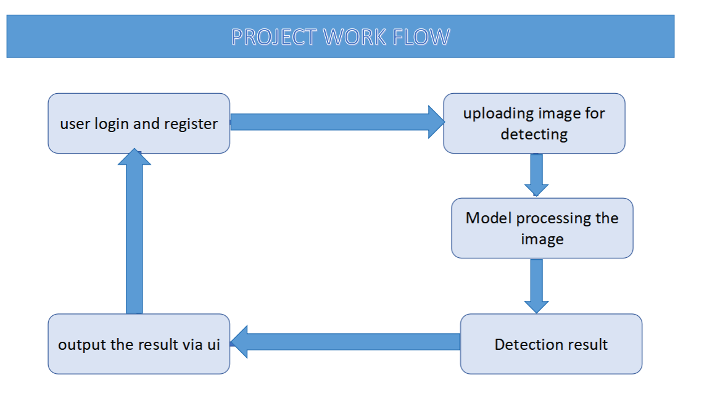

Slide 8
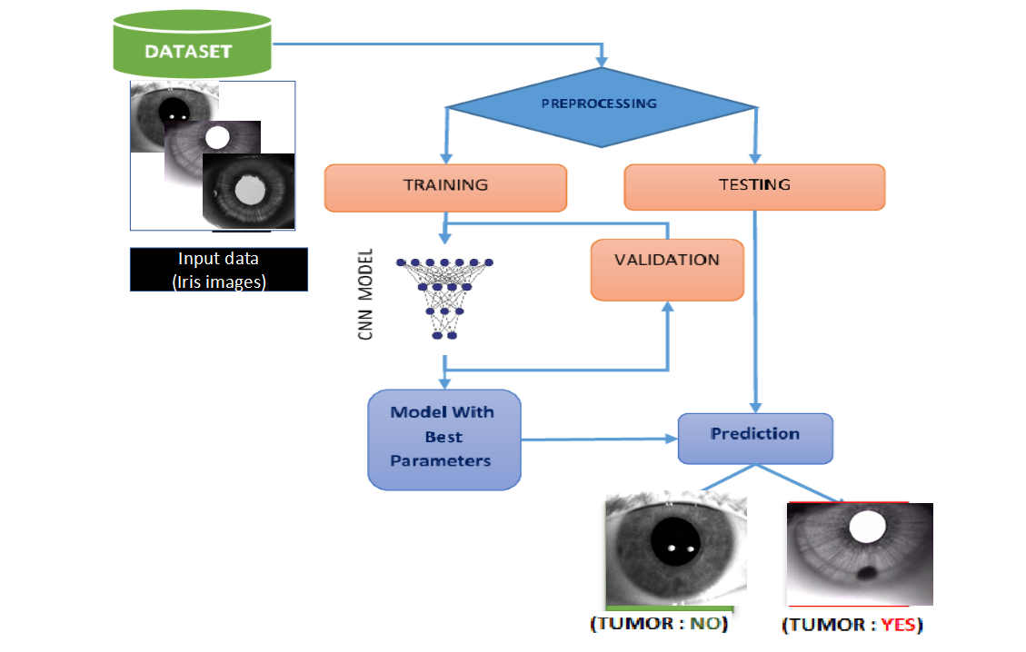
CNN model work flow

Slide 9
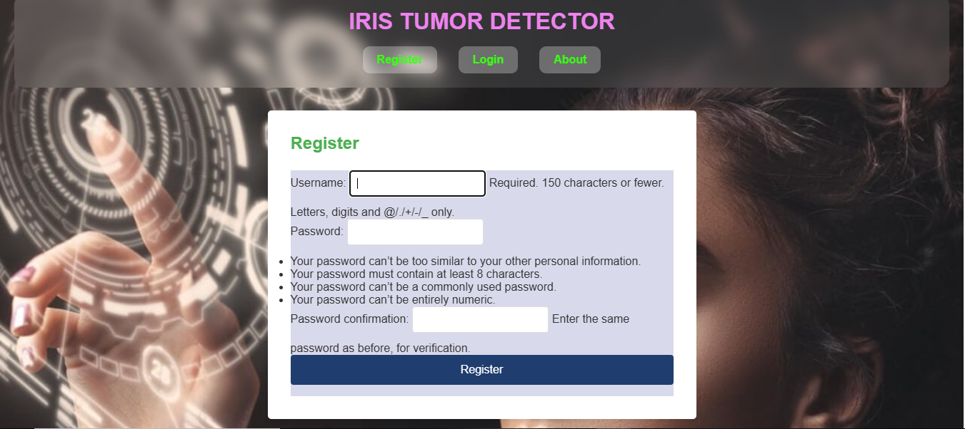
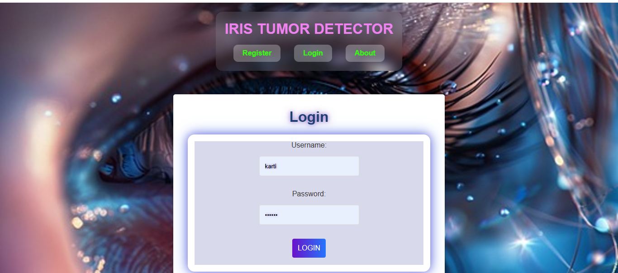
login and register

Slide 10
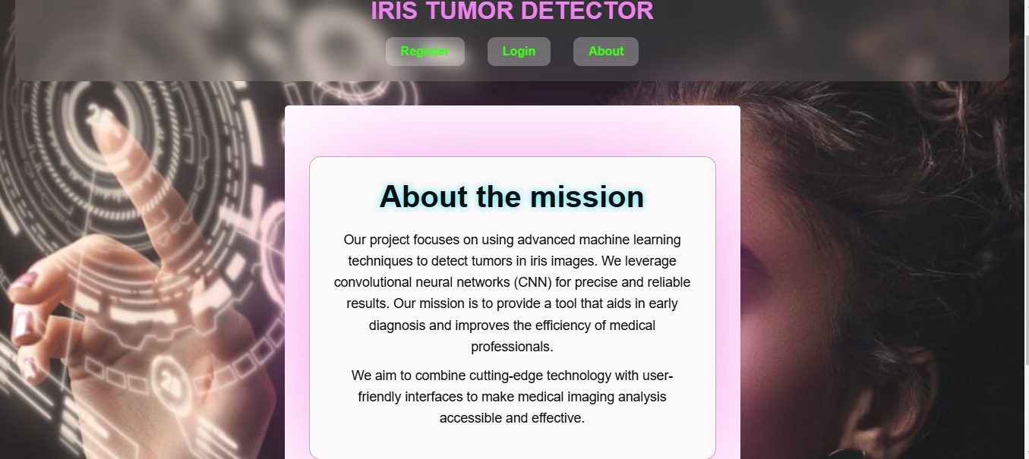
About the project

Slide 11
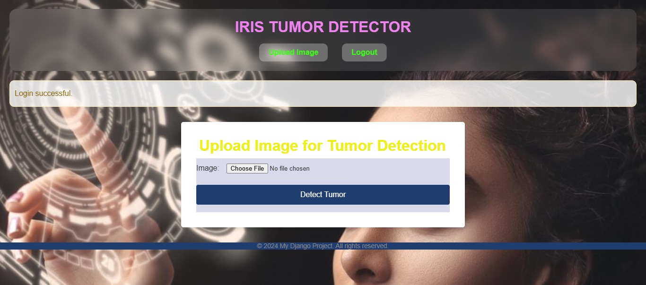
File uploading page

Slide 12
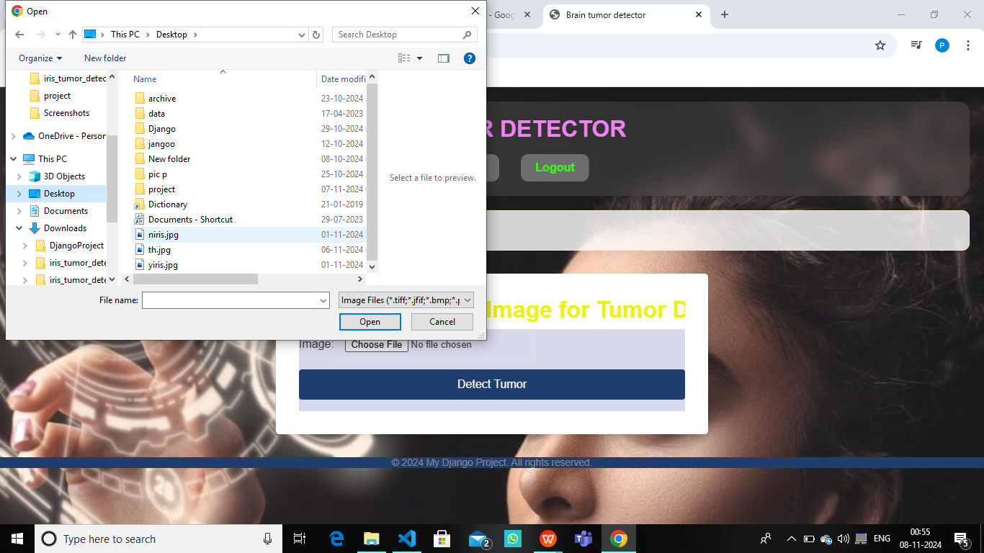
choose the file to upload

Slide 13
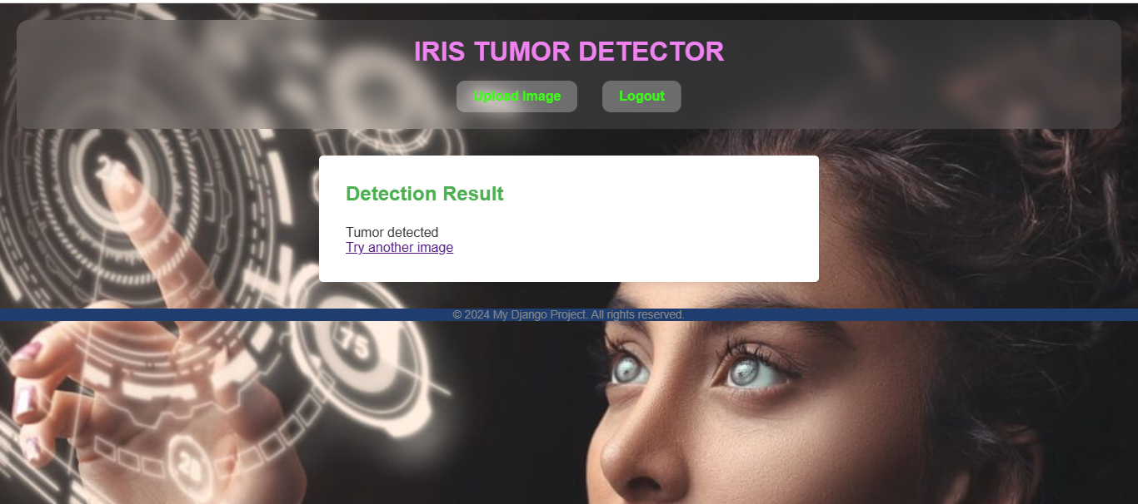
output to user if the iris having the tumor

Slide 14

output to user if no tumor is detected

Slide 15
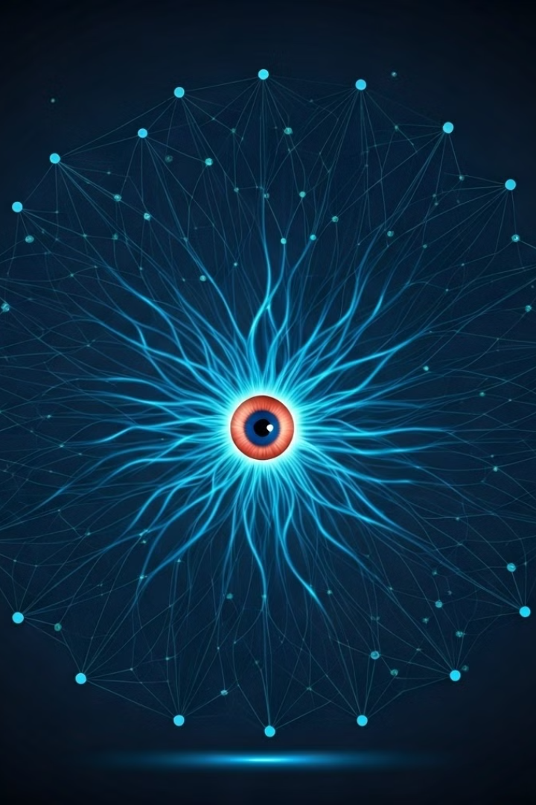
Conclusion and FutureScope :
Summary of Achievements:
This project demonstrates how CNNs can effectively detect iris tumors, achieving high accuracy and reliability.
This system offers healthcare professionals a valuable tool to streamline tumor detection, ultimately aiding in timely medical intervention and improving patient outcomes
Future Scope:
Extend the model to detect other types of eye tumors.
Deploy the model as a web application for broader accessibility.

Slide 16


